Slide 1
Defining the Landscape of HLA Risk Alleles in Primary Nephrotic Syndrome and Post Kidney Transplant Recurrence 1U01AI152585-01
Rasheed Gbadegesin, MBBS, MD
Annette Jackson, PhD
4/6/2021
Notes:
16

Slide 2
GENOMICS OF NS TEAM: DUKE
PEDIATRICS
Rasheed Gbadegesin
Eileen Chambers
Rachel Cason
Megan Chryst-Stangl
SURGERY AND IMMUNOLOGY
Annette Jackson
Brian Shaw
BIOSTATISTICS AND STATISTICAL GENETICS
Cliburn Chan
Alex Ochoa
Amika Sood
COLLABORATORS
Debo Adeyemo NHGRI
NMDP Consortium
PNRC

Slide 3
DATA ANALYSIS
Data:
HLA sequencing for 1500 NS cases, 1500 (BM) controls
Genotyping array data: >1.7 million SNPs
TOPMed Imputation Server
35x WGS, 1200 indiv. from CureGN (IgAN+MN+controls)
Binary traits: NS vs no-NS, SSNS vs SRNS, post-transplant recurrence
Association models for multiethnic (structured) populations:
HapQTL for haplotype association, Mixed-effect model, Firth logistic regression with PCA, LIGERA (developed by Dr. Ochoa)
Condition on known variants, local ancestry
Evaluate test statistic inflation, power, in simulations

Slide 4
DATA ANALYSIS
Annotations:
NCBI and ensemble genome browsers
Regulatory regions: ENCODE, RoadMap Epigenomics
Ancestry:
Subanalysis: single-ancestry tests, for identifying weaker ancestry-specific effects
Global ancestry estimation with ALStructure
Efficient Local Ancestry Inference (ELAI)

Slide 5
PRELIMINARY ANALYSIS
Preliminary analysis: 750 SSNS cases only, array
Not imputed (first pass)
Control samples: practically any adults
1000 Genomes Project: WGS, includes Sri Lankan (STU)!
Duke CATHGEN: whole-exome sequencing, greater number of African-American samples
Problem: array bias perfectly confounded with case/control status!
Partial fix: more aggressive filtering, including double Hardy-Weinberg Equilibrium (HWE) test, before and after merging
Plan: Develop a population genetics approach for cross-platform QC

Slide 6
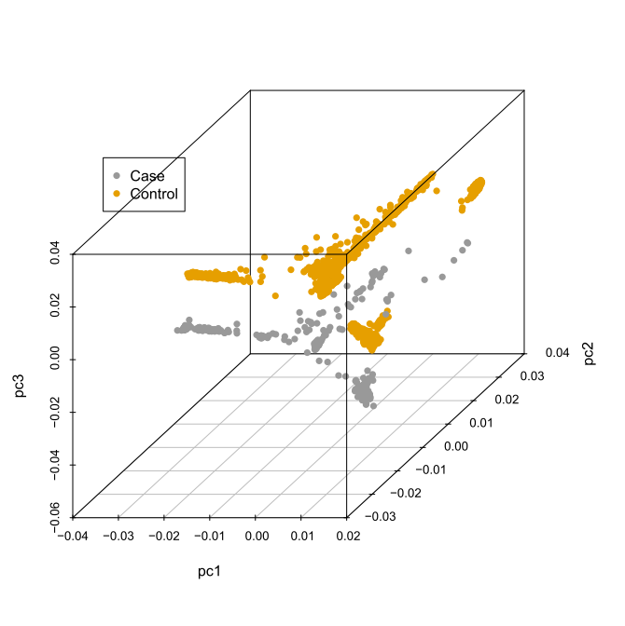
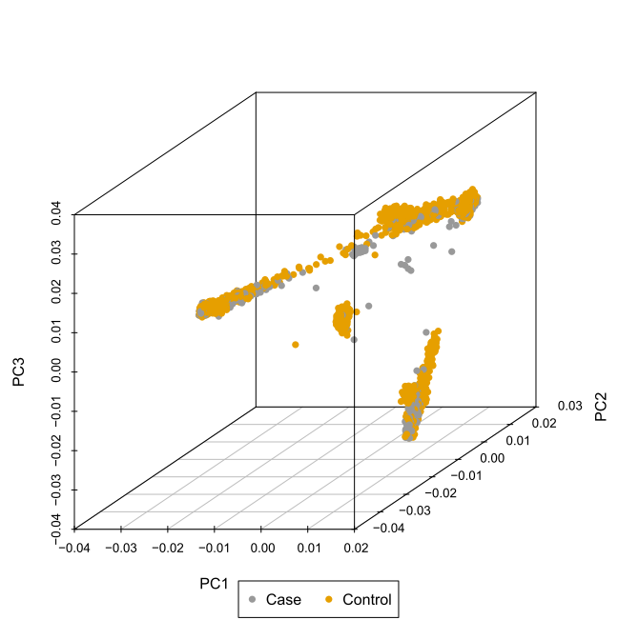

PRELIMINARY ANALYSIS
Array (cases) + 1000 Genomes (controls) simple merge: case/control separation!
Double HWE filter (before and after merge): cases and controls overlap!

Slide 7
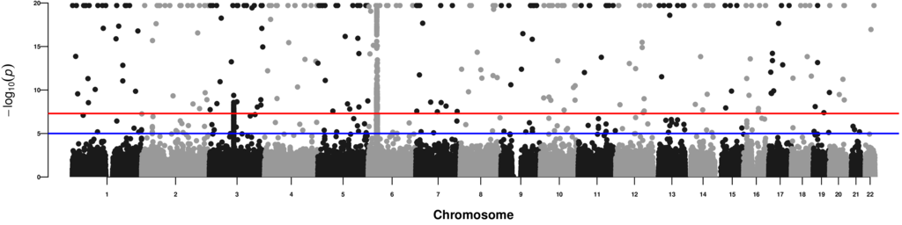
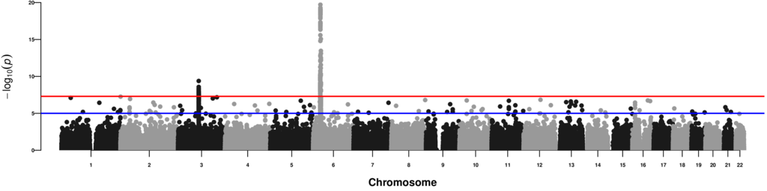
PRELIMINARY ANALYSIS
Top: association statistics remain inflated!
Bottom: significant cases without significant neighbors removed (false positives)

Slide 8
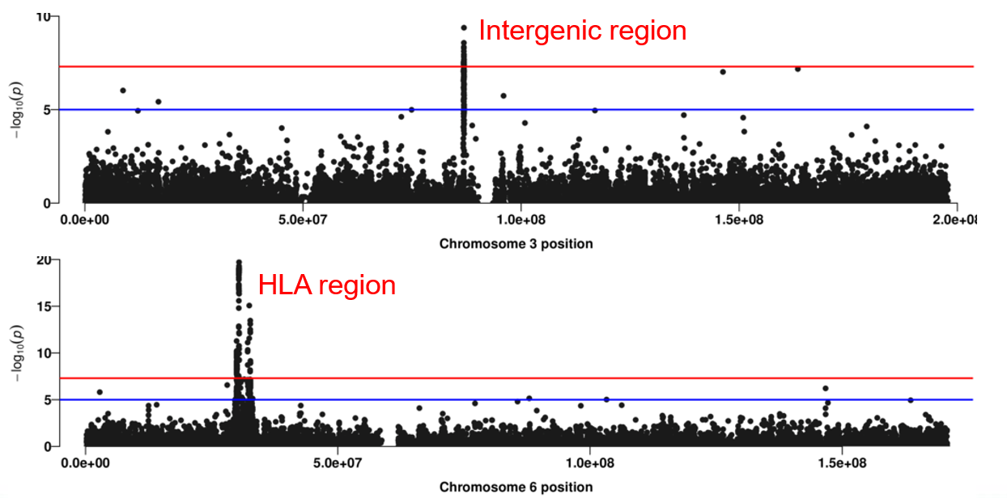
PRELIMINARY ANALYSIS

Slide 9
Other proposed analyses in Years 3-5
Aim 3
Is there differential expression of risk and non-risk alleles?
If so, what determines differential expression?
Aim 4
Can we predict disease recurrence following kidney transplantation?

Slide 10
Is there differential expression of risk and non-risk alleles?
Hypothesis:
HLA class II expression levels are different for risk and non-risk alleles
HLA class II expression levels are different during remission and relapse in SSNS patients
Comparison groups
Subjects with 0 copies of risk allele vs 1-2 copies of risk allele (unpaired)
Subjects in remission vs relapse (paired)
Measurements
HLA allele-specific mRNA using B cells from PBMC
HLA allele-specific surface expression using B cells from PBMC
RNAscope® in situ hybridization of kidney tissue

Slide 11
What determines differential expression?
Bioinformatics to identify structural and functional motifs
Effect of aa change on protein secondary structure and function
Anchor pockets within the peptide binding groove
Motifs that allow tapasin-independent assembly
3’ UTR polymorphisms that influence RNA stability, translation, and microRNA binding
Variations in known regulatory regions (binding sites IRF4, CTCF, XL9)
Tools and pipelines
I-TASSER server (http://zhanglab.ccmb.med.umich.edu/I-TASSER/)
PolyPhen, Sift, MutationTaster, IEDB T Cell Epitope Prediction Tools

Slide 12
Can we predict disease recurrence following kidney transplantation?
Track 250 patients who have kidney transplant for NS for 1 year
Primary outcome – recurrence of NS
Variables of interest – HLA risk allele profile
Multivariate logistic regression adjusting for demographic, clinical, donor and treatment variables

Slide 13
DATA SHARING
Follow data sharing guidelines agreed upon by consortium:
Data format
Data annotation
Public repository

Slide 14
New analytic tools
Source code will be on GitHub
Packages will be submitted to appropriate repository – CRAN, Bioconductor, PyPI

Slide 15
SHARED RESOURCES/FEEDBACK
Well defined control cohorts >2,000 with genotyping using multi ancestry genotyping chip
Areas seeking feedback from consortium members
HLA demographic and genomic data for center-specific controls
We are open to suggestions on how to do this more efficiently and make it PANDEMIC PROOF!!!!!

Slide 16
GENOMICS OF NS TEAM: DUKE
PEDIATRICS
Rasheed Gbadegesin
Eileen Chambers
Rachel Cason
Megan Chryst-Stangl
SURGERY AND IMMUNOLOGY
Annette Jackson
Brian Shaw
BIOSTATISTICS AND STATISTICAL GENETICS
Cliburn Chan
Alex Ochoa
Amika Sood
COLLABORATORS
Debo Adeyemo NHGRI
NMDP Consortium
PNRC

